Slide 1
Memory Management
Swapping
Contiguous Allocation
Paging
Segmentation
Segmentation with Paging
Dr. Hitendra Garg, Associate Professor, GLA University

Slide 2
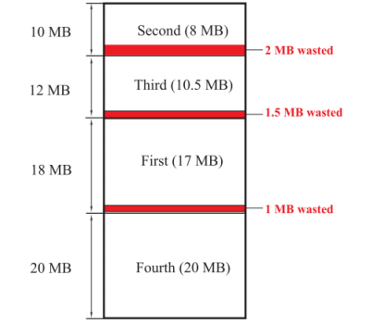
A multiprogramming operation system uses an apportioning scheme and divides the 60 MB of available memory into four partitions of 10 MB, 12 MB, 18 MB, and 20MB. The first program to be run needs 17 MB and occupies the third partition. The second program needs 8 MB and occupies the first partition. The third program needs 10.5 MB and occupies the second partition. Finally, the fourth program needs 20 MB and occupies the fourth partition. What is the total memory used? And is the total memory wasted? What percentage of memory is wasted? (10%)
Total memory used = 17 + 8 + 10.5 + 20 = 55.5 MB.
Total memory wasted = 2 + 1.5 +1 = 4.5 MB.
Percent memory wasted = 4.5 / 60 × 100 = 7.5%.
Dr. Hitendra Garg, Associate Professor, GLA University

Slide 3
Allocation of Frames
Each process needs minimum number of pages
Minimum is defined by the computer architecture
Two major allocation schemes
  Fixed allocation
  Priority allocation
Use a proportional allocation scheme using priorities rather than size
If process P_{i} generates a page fault,
  select for replacement one of its frames
  select for replacement a frame from a process with lower priority number
Dr. Hitendra Garg, Associate Professor, GLA University

Slide 4


Fixed Allocation
Equal allocation – For example, if there are 100 frames and 5 processes, give each process 20 frames.
Proportional allocation – Allocate according to the size of process
Dr. Hitendra Garg, Associate Professor, GLA University

Slide 5
Say, there are 5 processes having 5, 10, 30, 40 and 50 frames respectively. Total 60 Frame are available.
Equal Allocation = 60 / 5 = 12 frames will be allocated each process.
Proportional allocation :
Mi=60
Si= 5, S2=10, S3= 30, S4=40 and S5 =50
a1= 5/135 x 60 = Approx 2
A2 = 10/135 x60 = Approx 4
A3 = 30/135 x 60 = Approx 13
A4 = 40/135x60= Approx 18
A5 = 50/135x60= Approx 22
Dr. Hitendra Garg, Associate Professor, GLA University

Slide 6


















Global vs. Local Allocation
Global replacement – process selects a replacement frame from the set of all frames; one process can take a frame from another
Local replacement – each process selects from only its own set of allocated frames
Dr. Hitendra Garg, Associate Professor, GLA University

Slide 7
Thrashing
If a process does not have “enough” pages, the page-fault rate is very high. This leads to:
  low CPU utilization due to [swap in] and out [swap out]] due to high I/O [due to high page fault].
  operating system thinks that it needs to increase the degree of multiprogramming[number of frames allocated to processes would further go down]
  another process added to the system[Increase in page fault rate, High Disk usage, CPU utilization gets lower and lower]
Thrashing ≡ a process is busy swapping pages in and out. Bring down thrashing and/or prevent the thrashing.
Dr. Hitendra Garg, Associate Professor, GLA University

Slide 8
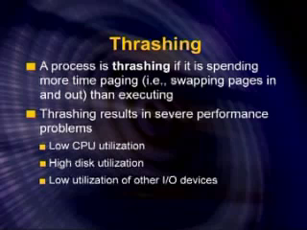
Dr. Hitendra Garg, Associate Professor, GLA University

Slide 9
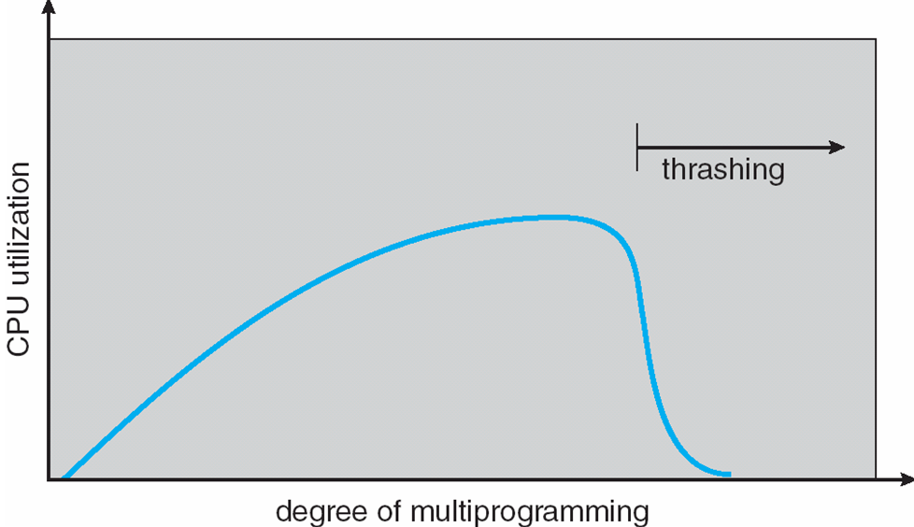
As the degree of multiprogramming increases , number of free frames as well number of pages allocated to each process decreases, which gives rise to the increase in page fault rate and ultimately THRASHING.
Dr. Hitendra Garg, Associate Professor, GLA University

Slide 10
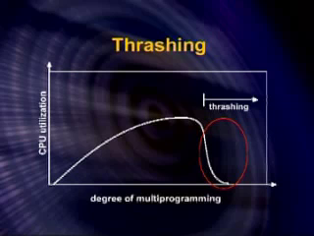
Dr. Hitendra Garg, Associate Professor, GLA University

Slide 11
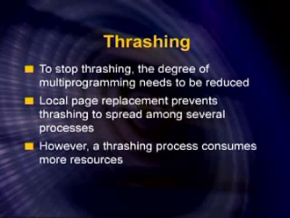
Dr. Hitendra Garg, Associate Professor, GLA University

Slide 12
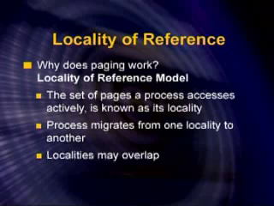
Dr. Hitendra Garg, Associate Professor, GLA University

Slide 13
Demand Paging and Thrashing
At a given instant of time, we only need to access certain set of pages, which is the subset of total number of pages in the address space of the process .
Set of pages in the process address space is known as locality.
Why does thrashing occur?
Σ size of locality > total memory size
Dr. Hitendra Garg, Associate Professor, GLA University

Slide 14
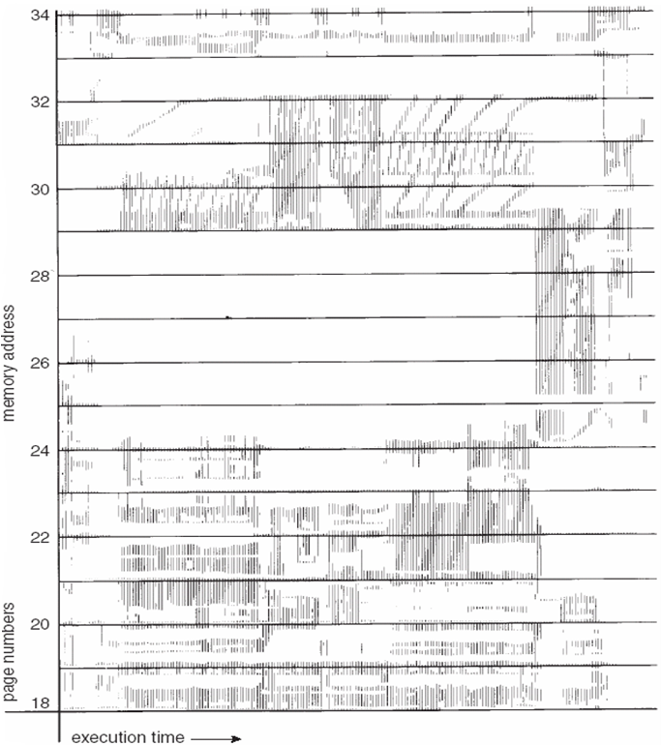
Locality In A Memory-Reference Pattern
Dr. Hitendra Garg, Associate Professor, GLA University

Slide 15
Dr. Hitendra Garg, Associate Professor, GLA University

Slide 16
Disk Structure
Disk drives are addressed as large 1-dimensional arrays of logical blocks, where the logical block is the smallest unit of transfer.
The 1-dimensional array of logical blocks is mapped into the sectors of the disk sequentially.
  Sector 0 is the first sector of the first track on the outermost cylinder.
  Mapping proceeds in order through that track, then the rest of the tracks in that cylinder, and then through the rest of the cylinders from outermost to innermost.
Dr. Hitendra Garg, Associate Professor, GLA University

Slide 17
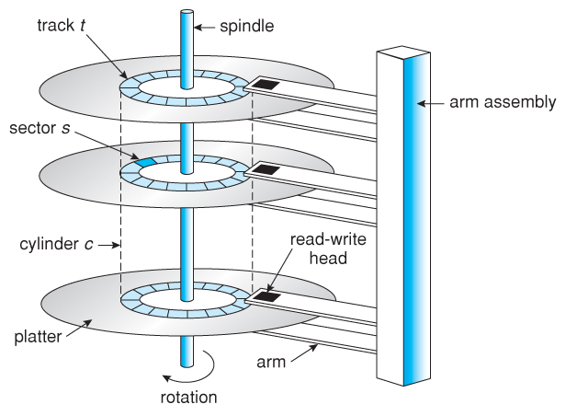
Dr. Hitendra Garg, Associate Professor, GLA University

Slide 18
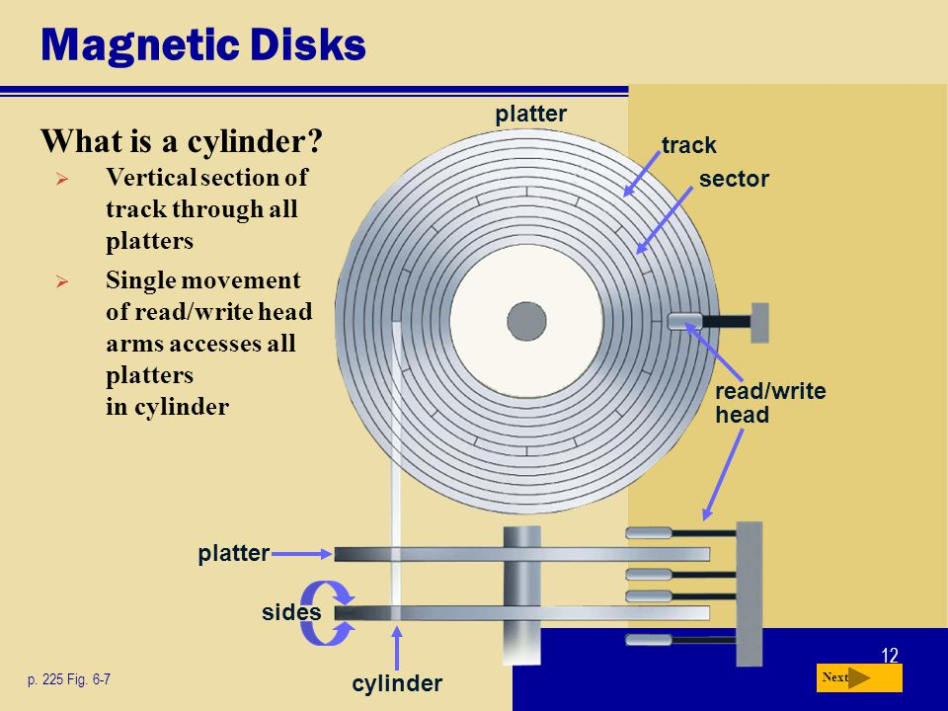
Dr. Hitendra Garg, Associate Professor, GLA University

Slide 19
Disk Scheduling
The operating system is responsible for using hardware efficiently — for the disk drives, this means having a fast access time and disk bandwidth.
Access time has two major components
  Seek time is the time for the disk are to move the heads to the cylinder containing the desired sector.
  Rotational latency is the additional time waiting for the disk to rotate the desired sector to the disk head.
Minimize seek time
Seek time ≈ seek distance
Disk bandwidth is the total number of bytes transferred, divided by the total time between the first request for service and the completion of the last transfer.
Dr. Hitendra Garg, Associate Professor, GLA University

Slide 20
Disk Scheduling (Cont.)
Several algorithms exist to schedule the servicing of disk I/O requests.
We illustrate them with a request queue (0-199).
98, 183, 37, 122, 14, 124, 65, 67
Head pointer 53
Dr. Hitendra Garg, Associate Professor, GLA University

Slide 21

FCFS
Illustration shows total head movement of 640 cylinders.
Dr. Hitendra Garg, Associate Professor, GLA University

Slide 22
SSTF
Selects the request with the minimum seek time from the current head position.
SSTF scheduling is a form of SJF scheduling; may cause starvation of some requests.
Illustration shows total head movement of 236 cylinders.
Dr. Hitendra Garg, Associate Professor, GLA University

Slide 23

SSTF (Cont.)
Dr. Hitendra Garg, Associate Professor, GLA University

Slide 24
SCAN
The disk arm starts at one end of the disk, and moves toward the other end, servicing requests until it gets to the other end of the disk, where the head movement is reversed and servicing continues.
Sometimes called the elevator algorithm.
Illustration shows total head movement of ____cylinders.
Dr. Hitendra Garg, Associate Professor, GLA University

Slide 25
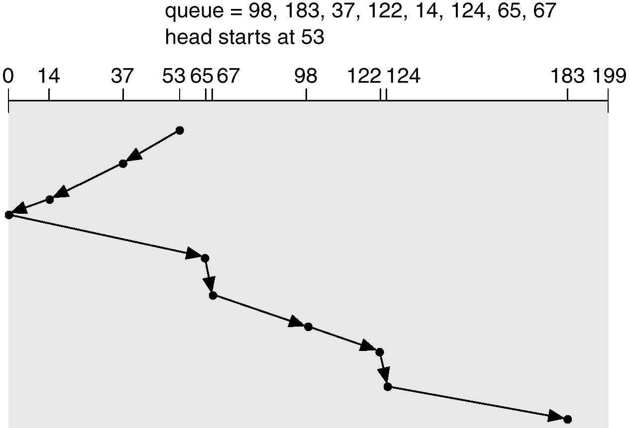
SCAN (Cont.)
Dr. Hitendra Garg, Associate Professor, GLA University

Slide 26
C-SCAN
Provides a more uniform wait time than SCAN.
The head moves from one end of the disk to the other. servicing requests as it goes.
When it reaches the other end, however, it immediately returns to the beginning of the disk, without servicing any requests on the return trip.
Treats the cylinders as a circular list that wraps around from the last cylinder to the first one.
Dr. Hitendra Garg, Associate Professor, GLA University

Slide 27

C-SCAN (Cont.)
Dr. Hitendra Garg, Associate Professor, GLA University

Slide 28


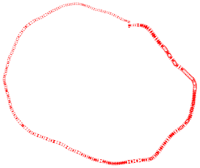
LOOK
Version of SCAN
Arm only goes as far as the last request in each direction, then reverses direction immediately, without first going all the way to the end of the disk.
Dr. Hitendra Garg, Associate Professor, GLA University

Slide 29
C-LOOK
Version of C-SCAN
Arm only goes as far as the last request in each direction, then reverses direction immediately, without first going all the way to the end of the disk.
Dr. Hitendra Garg, Associate Professor, GLA University

Slide 30

C-LOOK (Cont.)
Dr. Hitendra Garg, Associate Professor, GLA University

Slide 31
Selecting a Disk-Scheduling Algorithm
SSTF is common and has a natural appeal
SCAN and C-SCAN perform better for systems that place a heavy load on the disk.
Performance depends on the number and types of requests.
Requests for disk service can be influenced by the file-allocation method.
The disk-scheduling algorithm should be written as a separate module of the operating system, allowing it to be replaced with a different algorithm if necessary.
Either SSTF or LOOK is a reasonable choice for the default algorithm.
Dr. Hitendra Garg, Associate Professor, GLA University

Slide 32
Disk Management
Low-level formatting, or physical formatting — Dividing a disk into sectors that the disk controller can read and write.
To use a disk to hold files, the operating system still needs to record its own data structures on the disk.
  Partition the disk into one or more groups of cylinders.
  Logical formatting or “making a file system”.
Boot block initializes system.
  The bootstrap is stored in ROM.
  Bootstrap loader program.
Methods such as sector sparing used to handle bad blocks.
Dr. Hitendra Garg, Associate Professor, GLA University

Slide 33
Disk Scheduling Algorithm
Total Cylinders = 5000 [ 0-4999]
Head = 143, Previous Request =125
86 1470 913 1774 948 1509 1028 1750 130
Dr. Hitendra Garg, Associate Professor, GLA University

Slide 34
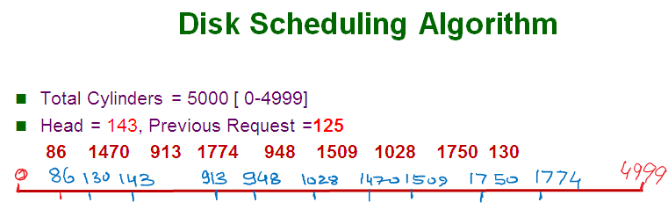
Dr. Hitendra Garg, Associate Professor, GLA University

Slide 35
Dr. Hitendra Garg, Associate Professor, GLA University

Slide 36
Dr. Hitendra Garg, Associate Professor, GLA University

Slide 37
Dr. Hitendra Garg, Associate Professor, GLA University

Slide 38
Dr. Hitendra Garg, Associate Professor, GLA University

Slide 39
Dr. Hitendra Garg, Associate Professor, GLA University

Slide 40
Calculate the Head movements
Work Queue: 23, 89, 132, 42, 187
there are 200 cylinders numbered from 0 - 199
the disk head stars at number 100
Assume Head is going inwards (i.e., towards 0)
Dr. Hitendra Garg, Associate Professor, GLA University

Slide 41
In _______ information is recorded magnetically on platters.
a) magnetic disks
b) electrical disks
c) Cache
d) RAM
Dr. Hitendra Garg, Associate Professor, GLA University

Slide 42
2. What is the disk bandwidth?
a) the total number of bytes transferred
b) total time between the first request for service and the completion on the last transfer
c) the total number of bytes transferred divided by the total
time between the first request for service and the
completion on the last transfer
d) none of the mentioned
Dr. Hitendra Garg, Associate Professor, GLA University

Slide 43








3. . The time taken for the desired sector to rotate to the disk head is called
a) positioning time
b) random access time
c) seek time
d) rotational latency
Dr. Hitendra Garg, Associate Professor, GLA University

Slide 44

4. The time taken to move the disk arm to the desired cylinder is called the
a) positioning time
b) random access time
c) seek time
d) rotational latency
Dr. Hitendra Garg, Associate Professor, GLA University

Slide 45
A CPU generates 32-bit virtual addresses. The page size is 8 KB. The processor has a translation look-aside buffer (TLB) which can hold a total of 128 page table entries and is 2-way set associative. The minimum size of the TLB tag is:
Answer Size of a page = 8KB = 2^13
Total number of bits needed to address a page frame = 32 – 13 = 19
If there are ‘n’ cache lines in a set, the cache placement is called n-way set associative.
Since TLB is 2 way set associative and can hold total 128 (2^7) page table entries, number of sets in cache = 2^7/2 = 128/2= 64 = 2^6.
So 6 bits are needed to address a set, and
13 (19 – 6) bits are needed for tag.
Dr. Hitendra Garg, Associate Professor, GLA University

Slide 46
Paged Segmentation
Dr. Hitendra Garg, Associate Professor, GLA University

Slide 47
Dr. Hitendra Garg, Associate Professor, GLA University

Slide 48
In a paged-segmented system , a virtual address consists of 32 bits of which 12 bits are displacement ,11 bits segment number and 9 bits are page numbers. Calculate the following:
  Page size
  Max segment size
  Max number of Pages
  Max number of segments
Dr. Hitendra Garg, Associate Professor, GLA University

Slide 49
In a paged-segmented system , a virtual address consists of 32 bits. There are 1024 segment and which segment is divided into pages to size 4096.
  Number of bits to represent segment no.
  Max number of Pages
  Number of Bits to represent page offset
Dr. Hitendra Garg, Associate Professor, GLA University

Slide 50
File-System Interface
File Concept
Access Methods
Directory Structure
File System Mounting
File Sharing
Protection
Dr. Hitendra Garg, Associate Professor, GLA University

Slide 51

File Concept
Named collection of related information stored on secondary storage device.
Data can not be written to secondary storage unless they are written within file.
Contiguous logical address space
Types:
  Data
    numeric
    character
    binary
  Program
Dr. Hitendra Garg, Associate Professor, GLA University

Slide 52
File Attributes
Name – only information kept in human-readable form.
Type – needed for systems that support different types.
Location – pointer to file location on device.
Size – current file size.
Protection – controls who can do reading, writing, executing.
Time, date, and user identification – data for protection, security, and usage monitoring.
Information about files are kept in the directory structure, which is maintained on the disk.
Dr. Hitendra Garg, Associate Professor, GLA University

Slide 53
File Operations
Create
Write
Read
Reposition within file – file seek
Delete
Truncate
Open(F_{i}) – search the directory structure on disk for entry F_{i}, and move the content of entry to memory.
Close (F_{i}) – move the content of entry F_{i} in memory to directory structure on disk.
Dr. Hitendra Garg, Associate Professor, GLA University

Slide 54

File Types – Name, Extension
Dr. Hitendra Garg, Associate Professor, GLA University

Slide 55

Access Methods
Sequential Access
read next
write next
reset
no read after last write
(rewrite)
Direct Access
read n
write n
position to n
read next
write next
rewrite n
n = relative block number
Dr. Hitendra Garg, Associate Professor, GLA University

Slide 56

Sequential-access File
Dr. Hitendra Garg, Associate Professor, GLA University

Slide 57

Simulation of Sequential Access on a Direct-access File
Dr. Hitendra Garg, Associate Professor, GLA University

Slide 58

Example of Index and Relative Files
Dr. Hitendra Garg, Associate Professor, GLA University

Slide 59
Directory Structure
A collection of nodes containing information about all files.
Directory
Files
F 1
F 2
F 3
F 4
F n
Both the directory structure and the files reside on disk.
Backups of these two structures are kept on tapes.
Dr. Hitendra Garg, Associate Professor, GLA University

Slide 60

A Typical File-system Organization
Dr. Hitendra Garg, Associate Professor, GLA University

Slide 61
Operations Performed on Directory
Search for a file
Create a file
Delete a file
List a directory
Rename a file
Traverse the file system
Dr. Hitendra Garg, Associate Professor, GLA University

Slide 62
Organize the Directory (Logically) to Obtain
Efficiency – locating a file quickly.
Naming – convenient to users.
  Two users can have same name for different files.
  The same file can have several different names.
Grouping – logical grouping of files by properties, (e.g., all Java programs, all games, …)
Dr. Hitendra Garg, Associate Professor, GLA University

Slide 63

Single-Level Directory
A single directory for all users.
Naming problem
Grouping problem
Dr. Hitendra Garg, Associate Professor, GLA University

Slide 64

Two-Level Directory
Separate directory for each user.
Path name
Can have the same file name for different user
Efficient searching
No grouping capability
Dr. Hitendra Garg, Associate Professor, GLA University

Slide 65

Tree-Structured Directories
Dr. Hitendra Garg, Associate Professor, GLA University

Slide 66
Tree-Structured Directories (Cont.)
Efficient searching
Grouping Capability
Current directory (working directory)
  cd /spell/mail/prog
  type list
Dr. Hitendra Garg, Associate Professor, GLA University

Slide 67
Tree-Structured Directories (Cont.)
Absolute or relative path name
Creating a new file is done in current directory.
Delete a file
rm <file-name>
Creating a new subdirectory is done in current directory.
  mkdir <dir-name>
Example: if in current directory /mail
mkdir count
mail
prog
copy
prt
exp
count
Deleting “mail” ⇒ deleting the entire subtree rooted by “mail”.
Dr. Hitendra Garg, Associate Professor, GLA University

Slide 68

Acyclic-Graph Directories
Have shared subdirectories and files.
Dr. Hitendra Garg, Associate Professor, GLA University

Slide 69
Protection
File owner/creator should be able to control:
  what can be done
  by whom
Types of access
  Read
  Write
  Execute
  Append
  Delete
  List
Dr. Hitendra Garg, Associate Professor, GLA University

Slide 70
Access Lists and Groups
Mode of access: read, write, execute
Three classes of users
RWX
a) owner access 7 ⇒ 1 1 1
RWX
b) group access 6 ⇒ 1 1 0
RWX
c) public access 1 ⇒ 0 0 1
Ask manager to create a group (unique name), say G, and add some users to the group.
For a particular file (say game) or subdirectory, define an appropriate access.
owner
group
public
chmod
761
game
Attach a group to a file
chgrp G game
Dr. Hitendra Garg, Associate Professor, GLA University

Slide 71
File System Implementation
Dr. Hitendra Garg, Associate Professor, GLA University

Slide 72

Layered File System
Dr. Hitendra Garg, Associate Professor, GLA University

Slide 73

A Typical File Control Block
Dr. Hitendra Garg, Associate Professor, GLA University

Slide 74
Directory Implementation
Linear list of file names with pointer to the data blocks.
  simple to program
  time-consuming to execute
Hash Table – linear list with hash data structure.
  decreases directory search time
  collisions – situations where two file names hash to the same location
  fixed size
Dr. Hitendra Garg, Associate Professor, GLA University

Slide 75
Allocation Methods
An allocation method refers to how disk blocks are allocated for files:
Contiguous allocation
Linked allocation
Indexed allocation
Dr. Hitendra Garg, Associate Professor, GLA University

Slide 76
Contiguous Allocation
Each file occupies a set of contiguous blocks on the disk.
Simple – only starting location (block #) and length (number of blocks) are required.
Random access.
Wasteful of space (dynamic storage-allocation problem).
Files cannot grow.
Dr. Hitendra Garg, Associate Professor, GLA University

Slide 77

Contiguous Allocation of Disk Space
Dr. Hitendra Garg, Associate Professor, GLA University

Slide 78
Extent-Based Systems
Many newer file systems (I.e. Veritas File System) use a modified contiguous allocation scheme.
Extent-based file systems allocate disk blocks in extents.
An extent is a contiguous block of disks. Extents are allocated for file allocation. A file consists of one or more extents.
Dr. Hitendra Garg, Associate Professor, GLA University

Slide 79
Linked Allocation
Each file is a linked list of disk blocks: blocks may be scattered anywhere on the disk.
block =
pointer
Dr. Hitendra Garg, Associate Professor, GLA University

Slide 80
Linked Allocation (Cont.)
Simple – need only starting address
Free-space management system – no waste of space
No random access
Mapping
Q
LA/511
R
  Block to be accessed is the Qth block in the linked chain of blocks representing the file.
  Displacement into block = R + 1
Dr. Hitendra Garg, Associate Professor, GLA University

Slide 81

Linked Allocation
Dr. Hitendra Garg, Associate Professor, GLA University

Slide 82

File-Allocation Table
Dr. Hitendra Garg, Associate Professor, GLA University

Slide 83
Indexed Allocation
Brings all pointers together into the index block.
Logical view.
index table
Dr. Hitendra Garg, Associate Professor, GLA University

Slide 84

Example of Indexed Allocation
Dr. Hitendra Garg, Associate Professor, GLA University

Slide 85
Indexed Allocation (Cont.)
Need index table
Random access
Dynamic access without external fragmentation, but have overhead of index block.
Mapping from logical to physical in a file of maximum size of 256K words and block size of 512 words. We need only 1 block for index table.
Q
LA/512
R
Q = displacement into index table
R = displacement into block
Dr. Hitendra Garg, Associate Professor, GLA University

Slide 86
Indexed Allocation – Mapping (Cont.)
Mapping from logical to physical in a file of unbounded length (block size of 512 words).
Linked scheme – Link blocks of index table (no limit on size).
Q₁
LA / (512 x 511)
R₁
  Q₁ = block of index table
  R₁ is used as follows:
Q₂
R₁ / 512
R₂
  Q₂ = displacement into block of index table
  R₂ displacement into block of file:
Dr. Hitendra Garg, Associate Professor, GLA University

Slide 87
Indexed Allocation – Mapping (Cont.)
Two-level index (maximum file size is 512³)
Q₁
LA / (512 x 512)
R₁
  Q₁ = displacement into outer-index
  R₁ is used as follows:
Q₂
R₁ / 512
R₂
  Q₂ = displacement into block of index table
  R₂ displacement into block of file:
Dr. Hitendra Garg, Associate Professor, GLA University

Slide 88
Indexed Allocation – Mapping (Cont.)

outer-index
index table
file
Dr. Hitendra Garg, Associate Professor, GLA University

Slide 89
Free-Space Management
Bit vector (n blocks)
0
1
2
n-1
…
0 ⇒ block[i] free
1 ⇒ block[i] occupied
bit[i] =

Block number calculation
(number of bits per word) *
(number of 0-value words) +
offset of first 1 bit
Dr. Hitendra Garg, Associate Professor, GLA University

Slide 90
Free-Space Management (Cont.)
Bit map requires extra space. Example:
block size = 2¹² bytes
disk size = 2³⁰ bytes (1 gigabyte)
n = 2³⁰/2¹² = 2¹⁸ bits (or 32K bytes)
Easy to get contiguous files
Linked list (free list)
  Cannot get contiguous space easily
  No waste of space
Grouping
Counting
Dr. Hitendra Garg, Associate Professor, GLA University

Slide 91
Free-Space Management (Cont.)
Need to protect:
  Pointer to free list
  Bit map
    Must be kept on disk
    Copy in memory and disk may differ.
    Cannot allow for block[i] to have a situation where bit[i] = 1 in memory and bit[i] = 0 on disk.
  Solution:
    Set bit[i] = 1 in disk.
    Allocate block[i]
    Set bit[i] = 1 in memory
Dr. Hitendra Garg, Associate Professor, GLA University

Slide 92

Linked Free Space List on Disk
Dr. Hitendra Garg, Associate Professor, GLA University

Slide 93
Efficiency and Performance
Efficiency dependent on:
  disk allocation and directory algorithms
  types of data kept in file’s directory entry
Performance
  disk cache – separate section of main memory for frequently used blocks
  free-behind and read-ahead – techniques to optimize sequential access
  improve PC performance by dedicating section of memory as virtual disk, or RAM disk.
Dr. Hitendra Garg, Associate Professor, GLA University

Slide 94
Protection
Goals of Protection
Domain of Protection
Access Matrix
Implementation of Access Matrix
Dr. Hitendra Garg, Associate Professor, GLA University

Slide 95
Protection
Operating system consists of a collection of objects, hardware or software
Each object has a unique name and can be accessed through a well-defined set of operations.
Protection problem - ensure that each object is accessed correctly and only by those processes that are allowed to do so.
Dr. Hitendra Garg, Associate Professor, GLA University

Slide 96
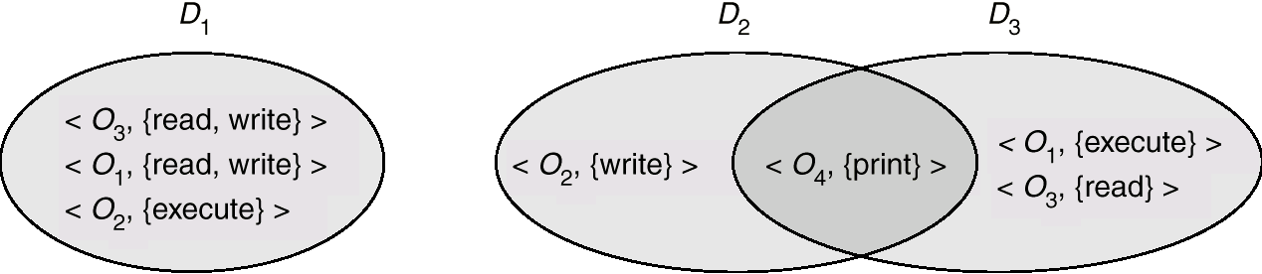
Domain Structure
Access-right = <object-name, rights-set>
where rights-set is a subset of all valid operations that can be performed on the object.
Domain = set of access-rights
Dr. Hitendra Garg, Associate Professor, GLA University

Slide 97
Domain Implementation (UNIX)
System consists of 2 domains:
  User
  Supervisor
UNIX
  Domain = user-id
  Domain switch accomplished via file system.
    Each file has associated with it a domain bit (setuid bit).
    When file is executed and setuid = on, then user-id is set to owner of the file being executed. When execution completes user-id is reset.
Dr. Hitendra Garg, Associate Professor, GLA University

Slide 98
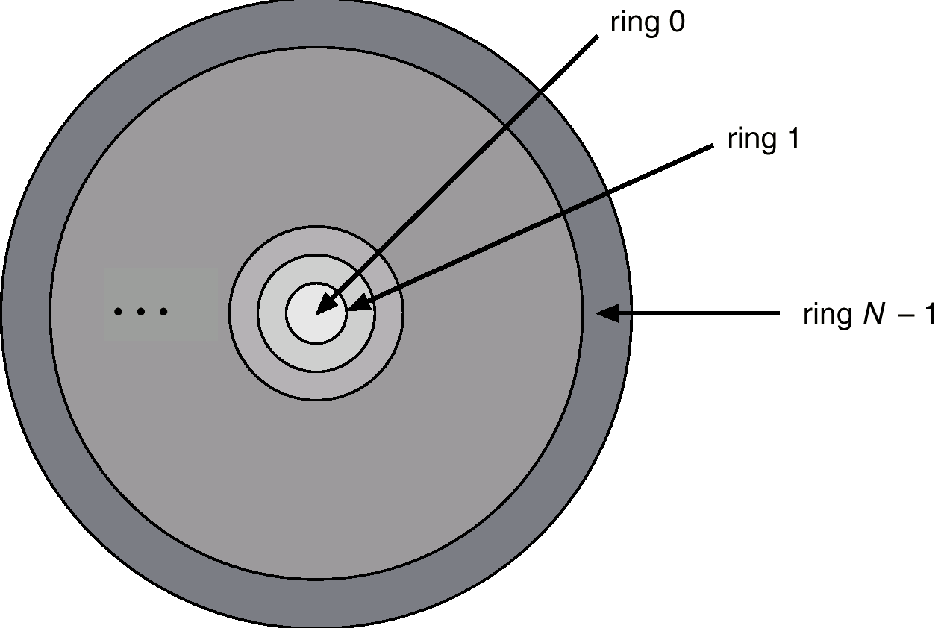
Domain Implementation (Multics)
Let D_{i} and D_{j} be any two domain rings.
If j < I ⇒ D_{i} ⊆ D_{j}
Multics Rings
Dr. Hitendra Garg, Associate Professor, GLA University

Slide 99
Access Matrix
View protection as a matrix (access matrix)
Rows represent domains
Columns represent objects
Access(i, j) is the set of operations that a process executing in Domain_{i} can invoke on Object_{j}
Dr. Hitendra Garg, Associate Professor, GLA University

Slide 100
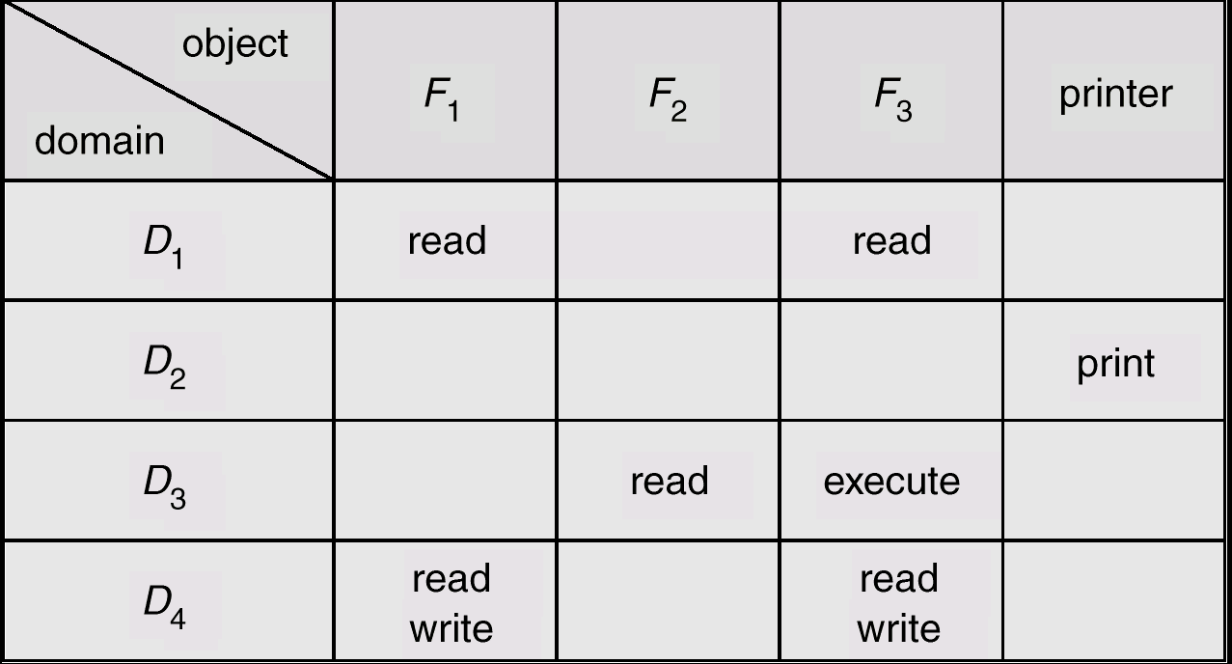
Access Matrix
Figure A
Dr. Hitendra Garg, Associate Professor, GLA University

Slide 101
Use of Access Matrix
If a process in Domain D_{i} tries to do “op” on object O_{j}, then “op” must be in the access matrix.
Can be expanded to dynamic protection.
  Operations to add, delete access rights.
  Special access rights:
    owner of O_{i}
    copy op from O_{i} to O_{j}
    control – D_{i} can modify D_{j} access rights
    transfer – switch from domain D_{i} to D_{j}
Dr. Hitendra Garg, Associate Professor, GLA University

Slide 102
Use of Access Matrix (Cont.)
Access matrix design separates mechanism from policy.
  Mechanism
    Operating system provides access-matrix + rules.
    If ensures that the matrix is only manipulated by authorized agents and that rules are strictly enforced.
  Policy
    User dictates policy.
    Who can access what object and in what mode.
Dr. Hitendra Garg, Associate Professor, GLA University

Slide 103
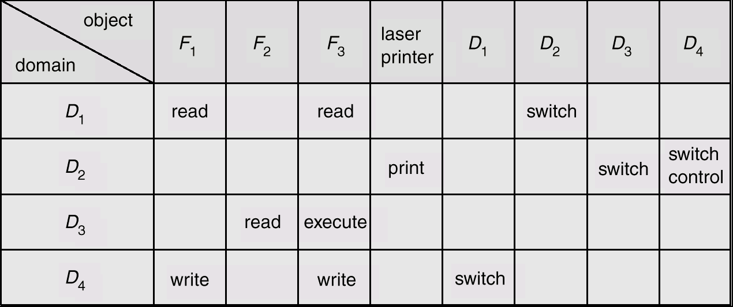
Modified Access Matrix
Dr. Hitendra Garg, Associate Professor, GLA University

Slide 104
Threads
Dr. Hitendra Garg, Associate Professor, GLA University

Slide 105
Threads
A thread is a flow of execution through the process code.
Program counter that keeps track of which instruction to execute next,
System registers which hold its current working variables
Stack which contains the execution history.
Dr. Hitendra Garg, Associate Professor, GLA University

Slide 106
Threads
A Thread is also called a lightweight process.
Threads provide a way to improve application performance through parallelism.
Threads represent a software approach to improving performance of operating system
Each thread belongs to exactly one process and no thread can exist outside a process.
Each thread represents a separate flow of control.
Threads have been successfully used in implementing network servers and web server.
They also provide a suitable foundation for parallel execution of applications on shared memory multiprocessors.
Dr. Hitendra Garg, Associate Professor, GLA University

Slide 107
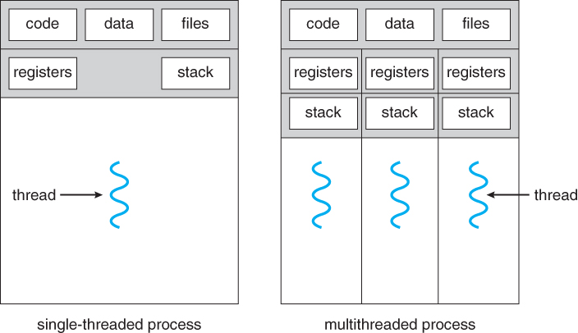
Single and Multithreaded Processes
Dr. Hitendra Garg, Associate Professor, GLA University

Slide 108
Process | Thread
Process is heavy weight or resource intensive. | Thread is light weight, taking lesser resources than a process.
Process switching needs interaction with operating system. | Thread switching does not need to interact with operating system.
In multiple processing environments, each process executes the same code but has its own memory and file resources. | All threads can share same set of open files, child processes.
If one process is blocked, then no other process can execute until the first process is unblocked. | While one thread is blocked and waiting, a second thread in the same task can run.
Multiple processes without using threads use more resources. | Multiple threaded processes use fewer resources.
In multiple processes each process operates independently of the others. | One thread can read, write or change another thread's data.
Dr. Hitendra Garg, Associate Professor, GLA University

Slide 109
Advantages of Thread
Threads minimize the context switching time.
Use of threads provides concurrency within a process.
Efficient communication.
It is more economical to create and context switch threads.
Threads allow utilization of multiprocessor architectures to a greater scale and efficiency.
Dr. Hitendra Garg, Associate Professor, GLA University

Slide 110
Benefits
Responsiveness
Resource Sharing
Economy
Utilization of MP Architectures
Dr. Hitendra Garg, Associate Professor, GLA University

Slide 111
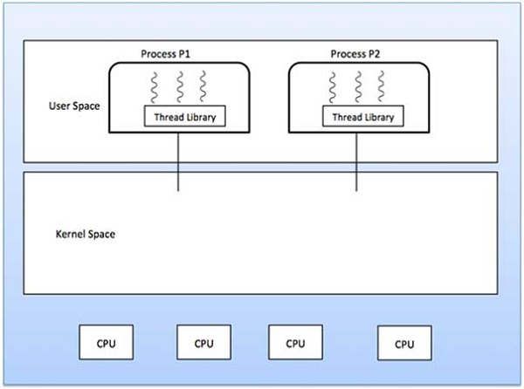
User Threads
Thread management done by user-level threads library
Dr. Hitendra Garg, Associate Professor, GLA University

Slide 112
Advantages of User Level Threads
Thread switching does not require Kernel mode privileges.
User level thread can run on any operating system.
Scheduling can be application specific in the user level thread.
User level threads are fast to create and manage.
Dr. Hitendra Garg, Associate Professor, GLA University

Slide 113
Kernel Level Threads
Thread management is done by the Kernel.
There is no thread management code in the application area.
Kernel threads are supported directly by the operating system.
Any application can be programmed to be multithreaded.
All of the threads within an application are supported within a single process.
Scheduling by the Kernel is done on a thread basis.
The Kernel performs thread creation, scheduling and management in Kernel space.
Kernel threads are generally slower to create and manage than the user threads.
Dr. Hitendra Garg, Associate Professor, GLA University

Slide 114
Multithreading Models
Many-to-One
One-to-One
Many-to-Many
Dr. Hitendra Garg, Associate Professor, GLA University

Slide 115
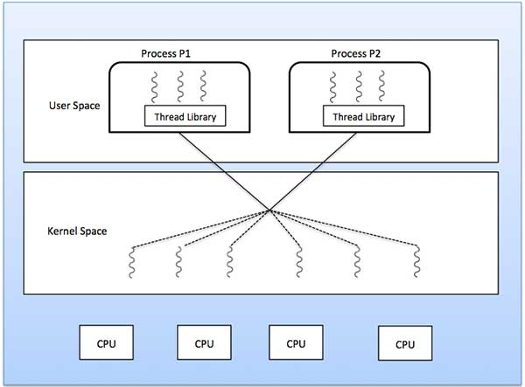
Many-to-Many
Dr. Hitendra Garg, Associate Professor, GLA University

Slide 116
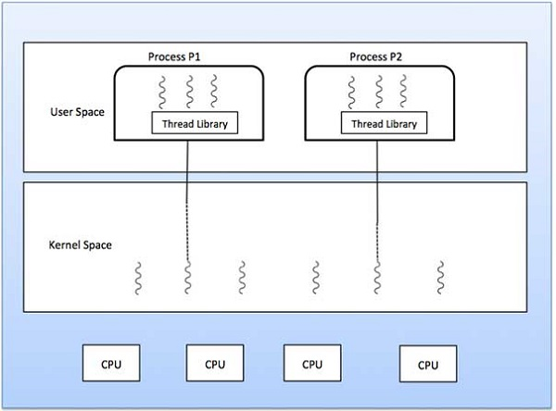
Many-to-One
Many user-level threads mapped to single kernel thread.
Used on systems that do not support kernel threads.
Dr. Hitendra Garg, Associate Professor, GLA University

Slide 117
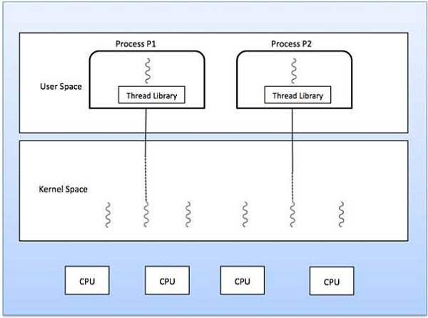
One-to-One
Dr. Hitendra Garg, Associate Professor, GLA University

Slide 118

Java Thread States
Dr. Hitendra Garg, Associate Professor, GLA University

Slide 119
Semaphores
Synchronization tool that does not require busy waiting.
Semaphore S – integer variable
can only be accessed via two indivisible (atomic) operations
wait (S):
while S≤ 0 do no-op;
S--;
signal (S):
S++;
Dr. Hitendra Garg, Associate Professor, GLA University

Slide 120
Readers-Writers Problem
Shared data
semaphore mutex, wrt;
Initially
mutex = 1, wrt = 1, readcount = 0
Dr. Hitendra Garg, Associate Professor, GLA University

Slide 121
Readers-Writers Problem Writer Process
Dr. Hitendra Garg, Associate Professor, GLA University

Slide 122
Writer Process
mutex = 1, wrt = 1, readcount = 0
do {
// writer requests for critical section
wait(wrt);
// performs the write
// leaves the critical section
signal(wrt);
} while(true);
Dr. Hitendra Garg, Associate Professor, GLA University

Slide 123
Readers-Writers Problem Reader Process
do{
wait(mutex);
readcount++;
if (readcount == 1)
wait(rt);
signal(mutex);
…
reading is performed
…
wait(mutex);
readcount--;
if (readcount == 0)
signal(wrt);
signal(mutex):
While(1);
Dr. Hitendra Garg, Associate Professor, GLA University

Slide 124
Considering a system with five processes P₀ through P₄ and three resources types A, B, C. Resource type A has 10 instances, B has 5 instances and type C has 7 instances. Suppose at time t₀ following snapshot of the system has been taken:
Process | Maximum Need | Allocation
 | A B C | A B C
P0 | 7 5 3 | 0 1 0
P1 | 3 2 2 | 2 0 0
P2 | 9 0 2 | 3 0 2
P3 | 2 2 2 | 2 1 1
P4 | 4 3 3 | 0 0 2
What will happen if process P₁ requests one additional instance of resource type A and two instances of resource type C? Is additional request by process P1 granted?
Dr. Hitendra Garg, Associate Professor, GLA University

Slide 125
Considering a system with five processes P₀ through P₄ and three resources types A, B, C. Resource type A has 10 instances, B has 5 instances and type C has 7 instances. Suppose at time t₀ following snapshot of the system has been taken:
Process | Maximum Need | Allocation
 | A B C | A B C
P0 | 7 5 3 | 0 1 0
P1 | 3 2 2 | 2 0 0
P2 | 9 0 2 | 3 0 2
P3 | 2 2 2 | 2 1 1
P4 | 4 3 3 | 0 0 2
What will happen if process P₁ requests one additional instance of resource type A and two instances of resource type C? Is additional request by process P1 granted?
Dr. Hitendra Garg, Associate Professor, GLA University

Slide 126
Considering a system with five processes P₀ through P₄ and three resources types A, B, C. Resource type A has 10 instances, B has 5 instances and type C has 7 instances. Suppose at time t₀ following snapshot of the system has been taken:
Process | Maximum Need | Allocation
 | A B C | A B C
P0 | 7 5 3 | 0 1 0
P1 | 3 2 2 | 2 0 0
P2 | 9 0 2 | 3 0 2
P3 | 2 2 2 | 2 1 1
P4 | 4 3 3 | 0 0 2
What will happen if process P₁ requests one additional instance of resource type A and two instances of resource type C? Is additional request by process P1 granted?
Dr. Hitendra Garg, Associate Professor, GLA University

Slide 127
Considering a system with five processes P₀ through P₄ and three resources types A, B, C. Resource type A has 10 instances, B has 5 instances and type C has 7 instances. Suppose at time t₀ following snapshot of the system has been taken:
Process | Maximum Need | Allocation
 | A B C | A B C
P0 | 7 5 3 | 0 1 0
P1 | 3 2 2 | 2 0 0
P2 | 9 0 2 | 3 0 2
P3 | 2 2 2 | 2 1 1
P4 | 4 3 3 | 0 0 2
What will happen if process P₁ requests one additional instance of resource type A and two instances of resource type C? Is additional request by process P1 granted?
Dr. Hitendra Garg, Associate Professor, GLA University

Slide 128
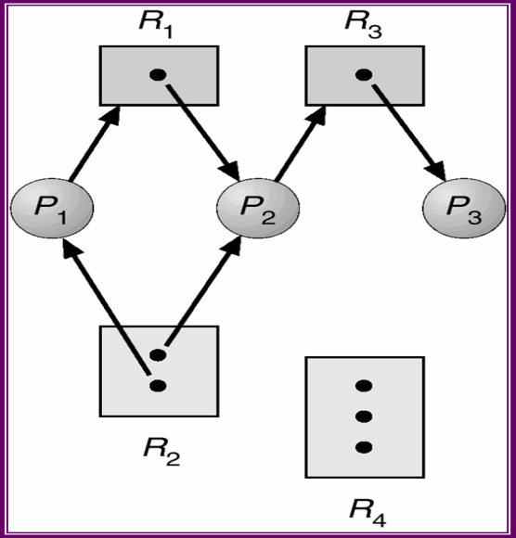
Dr. Hitendra Garg, Associate Professor, GLA University

Slide 129
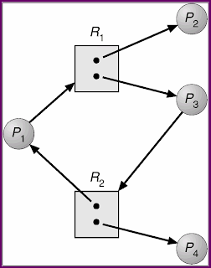
Dr. Hitendra Garg, Associate Professor, GLA University

Slide 130
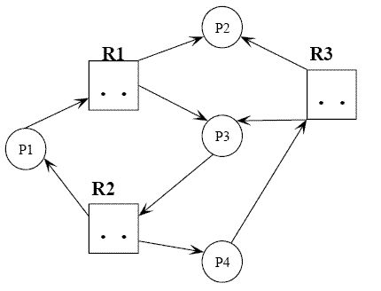

Dr. Hitendra Garg, Associate Professor, GLA University

Slide 131
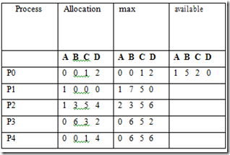
a. What is the Need matrix?
b. Is Safe sequence exist? What is the safe sequence?
c. Suppose P1 make an additional request for <0,4,2,0>. Can the extra request granted immediately?
Dr. Hitendra Garg, Associate Professor, GLA University

